Slide 1




CSC 341: Operating Systems - CPU Scheduling Research Project - Alex Cao - 12/18/2025 -
California State University Dominguez Hills
CPU Scheduling in MINIX 3 and Linux Using a cpuhog Program
Notes:
This project uses simple CPU‑hogging programs in MINIX 3 and Ubuntu Linux to see how real schedulers handle a process that never gives up the CPU, similar to heavy apps or browser tabs on a desktop system.

Slide 2
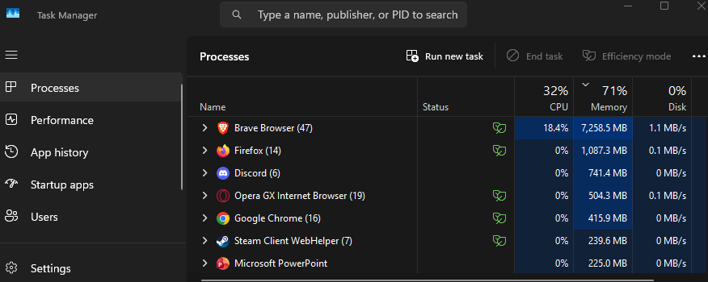
What is CPU Scheduling?
CPU can run one instruction stream per core at a time.
Many processes want the CPU.
Scheduler decides which ready process runs next.
Real example: Windows 11 sharing CPU among apps and browser tabs.
Notes:
Windows 11 juggles Chrome tabs, Discord, antivirus—all competing for CPU. The scheduler decides who runs next so your desktop stays responsive, not frozen.

Slide 3
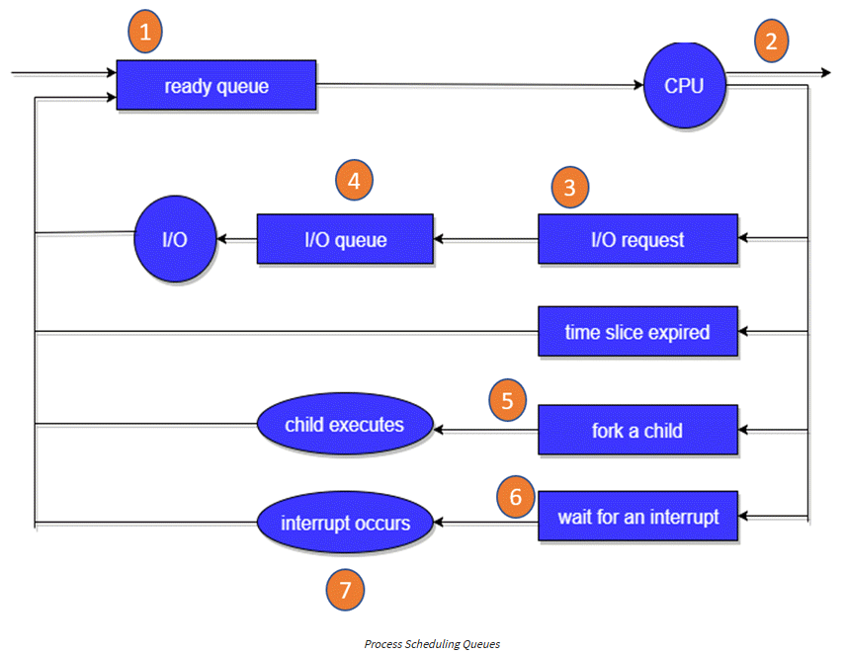
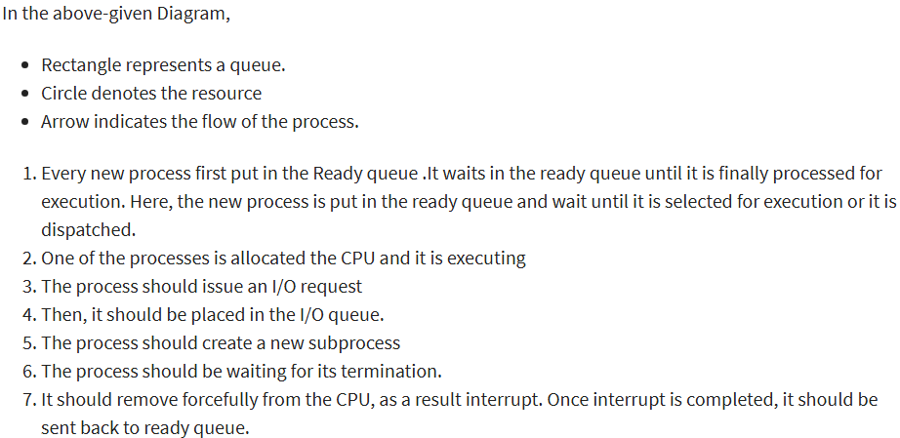
Preemption and Quanta
Non-preemptive: One game thread hogs CPU → entire game freezes
Preemptive: Timer (10-100ms) forces switches between game + browser
Short quantum: Smooth 60fps but more context switches
Long quantum: Fewer switches but input lag spikes
Notes:
- That half-second PC freeze happens when a background app hogs its full quantum, making desktop threads wait.
- In the above-given Diagram,
Rectangle represents a queue.
Circle denotes the resource
Arrow indicates the flow of the process.
Every new process first put in the Ready queue .It waits in the ready queue until it is finally processed for execution. Here, the new process is put in the ready queue and wait until it is selected for execution or it is dispatched.
One of the processes is allocated the CPU and it is executing
The process should issue an I/O request
Then, it should be placed in the I/O queue.
The process should create a new subprocess
The process should be waiting for its termination.
It should remove forcefully from the CPU, as a result interrupt. Once interrupt is completed, it should be sent back to ready queue.

Slide 4
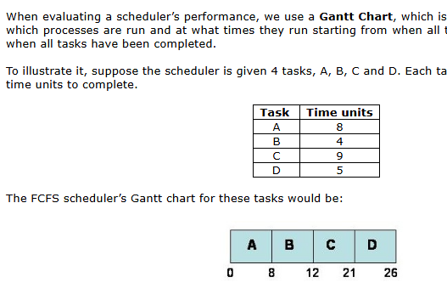
Why Quanta Matter
20 Chrome tabs: Heavy tabs hog CPU → light tabs starve
Short quanta: All tabs get turns → system stays smooth
PC stutter: One tab grabs full quantum → mouse lags 200ms
Game parallel: Heavy AI thread → frame timing spikes
Notes:
Convoy effect: Slow truck blocks fast cars (long job starves short ones)
Gantt Chart, which is a horizontal timeline indicating which processes are run and at what times they run starting from when all tasks are submitted and ending when all tasks have been completed.
suppose the scheduler is given 4 tasks, A, B, C and D. Each task requires a certain number of time units to complete.
The FCFS scheduler’s Gantt chart for these tasks would be:
The tasks are inserted into the queue in order A, B, C and D. as shown above. Task A takes 8 time units to complete, B takes 4 units to complete (therefore, B completes at time 12), etc. Task D ends at time 26, which is the time it took to run and complete all processes.

Slide 5
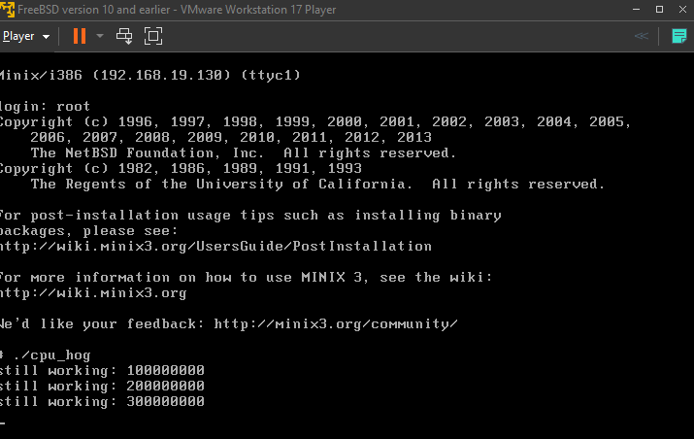

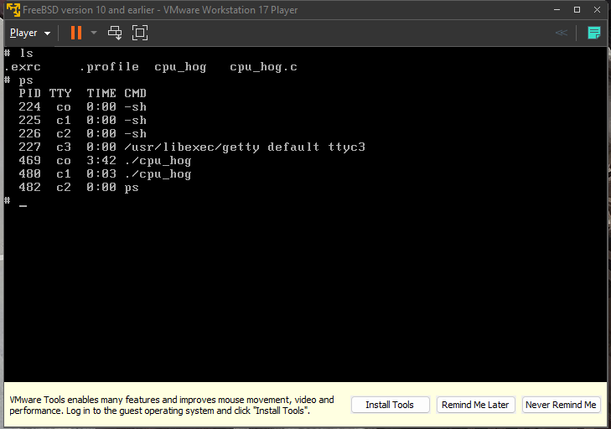
MINIX 3 cpuhog Experiment
MINIX 3 VM in VMware.
cpuhog.c: infinite loop, never yields (like background hog).
Observed in ps: ./cpu_hog running with PID, TTY, TIME, CMD.
Proof it's working: Accumulates TIME (CPU used), stays in process list.
Code Snippet:
volatile unsigned long long x = 0;
while (1) {
x++;
if (x % 100000000ULL == 0)
printf("still working: %llu\n", x);
}
Notes:
I ran `./cpu_hog` in MINIX 3. In `ps` (process status), I saw it listed with its PID and growing TIME—proof it's consuming CPU cycles steadily. It didn't hit 100% because MINIX's scheduler was already preempting it with quanta, just like it should. The 'still working' prints showed it kept running without freezing the system.
Ps (process status) showed cpuhog with growing TIME column—proof it's eating CPU steadily.
MINIX scheduler shared CPU so it never froze the system, just like it should.
PID: Unique ID number for each process
TTY: Which terminal it's attached to (like tty1)
TIME: CPU time used (minutes:seconds) – this grows as cpuhog works
CMD: Command name (./cpu_hog)

Slide 6
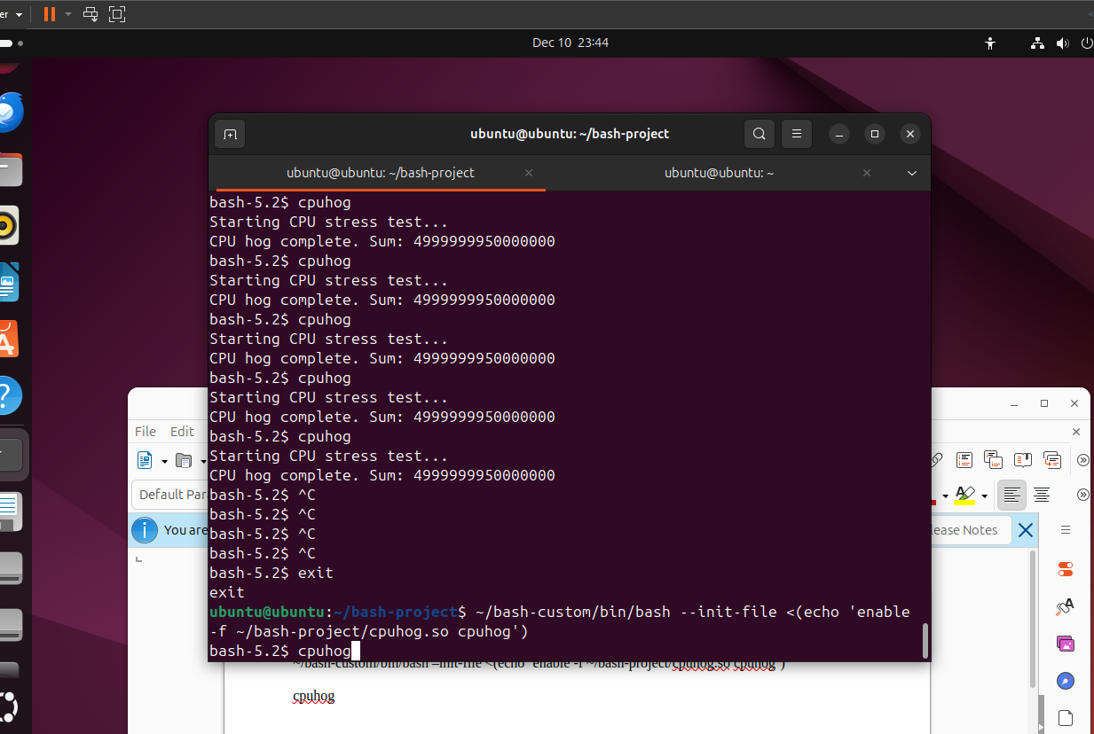
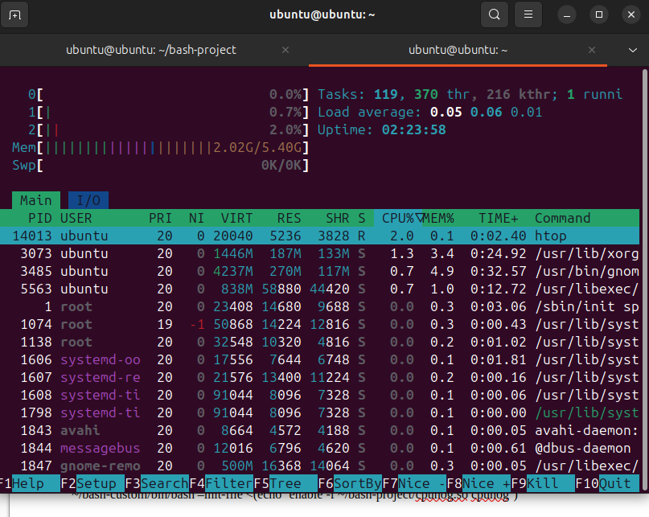
Linux Bash cpuhog Experiment
Ubuntu VM in VMware.
Custom Bash + loadable cpuhog builtin (CPU hog inside shell).
Observed: Bash spikes in top/htop but desktop stays responsive.
Notes:
I built custom Bash 5.2, loaded cpuhog builtin, and ran it 4 times. Each cycle printed 'Starting CPU stress test...' then 'CPU hog complete. Sum: 4999999950000000' after ~100 million iterations. htop showed bash process running, but the key proof? Desktop stayed smooth, no freeze. Linux CFS preempted it automatically.
Completely Fair Scheduler (CFS) uses a Red-Black tree data structure to maintain a time-ordered list of runnable tasks, sorted by their virtual runtime (vruntime), which tracks the amount of CPU time a task has consumed relative to others.
The task with the smallest vruntime is selected for execution next, ensuring that tasks that have used less CPU time are prioritized, which helps maintain interactivity and fairness, especially for I/O-bound processes.
htop didn't scream '100% CPU' (VMware throttles sometimes), but bash was there, 4 full cycles completed fast, and Ubuntu stayed responsive. That's CFS working, no hog takeover.

Slide 7
How the Schedulers Behaved
Aspect | MINIX 3 (User-mode SCHED) | Linux (CFS)
CPU hog | Steady CPU (TIME grows in ps) | 4 full cycles completed (sum output)
Preemption | Timer interrupts every quantum | Desktop responsive during runs
Other tasks | Terminal responsive, prints continue | Terminal took 4 more commands smoothly
Notes:
Using the Vmware workstation, MINIX showed steady CPU use in (process status) ps TIME, no freeze because of preemption. As well with Linux. Both prevent total lockup, just like your PC when a background hog causes those half-second hangs.

Slide 8



What You Learned
cpuhog = extreme background hog process
Growing TIME in ps = proof of CPU consumption
Quanta/preemption prevent total system freeze
PC hangs (100-500ms), browser tabs, game stutters = same principles
MINIX 3 & Linux: different mechanisms, same goals
Notes:
ps TIME growing steadily proved my cpuhog worked. Every PC hang you feel is scheduling doing its job—just like MINIX and Linux handled my experiments perfectly.

Slide 9
Presentation End

